Slide 1
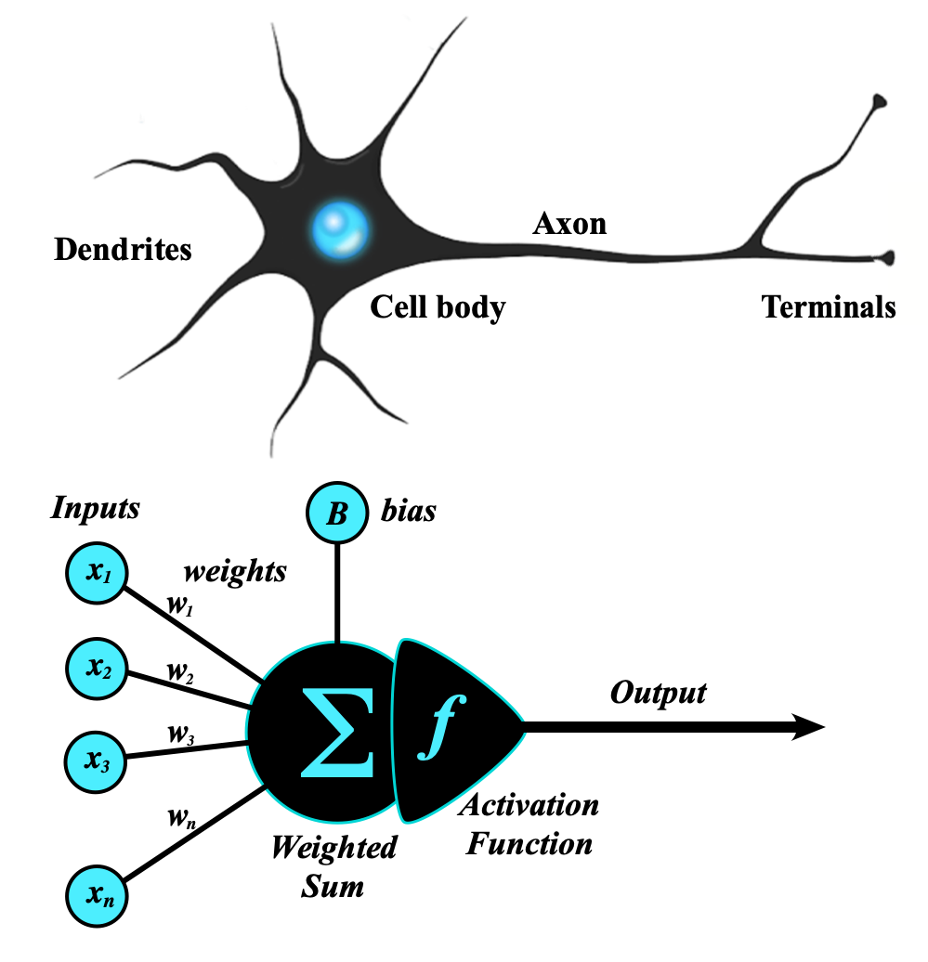
Module 1: The Artificial Neuron (Perceptron)
Welcome to Phase 5: Deep Learning, Computer Vision & LLMs!
Part 1 focuses on The Foundations of Artificial Neural Networks (ANN).

Slide 2
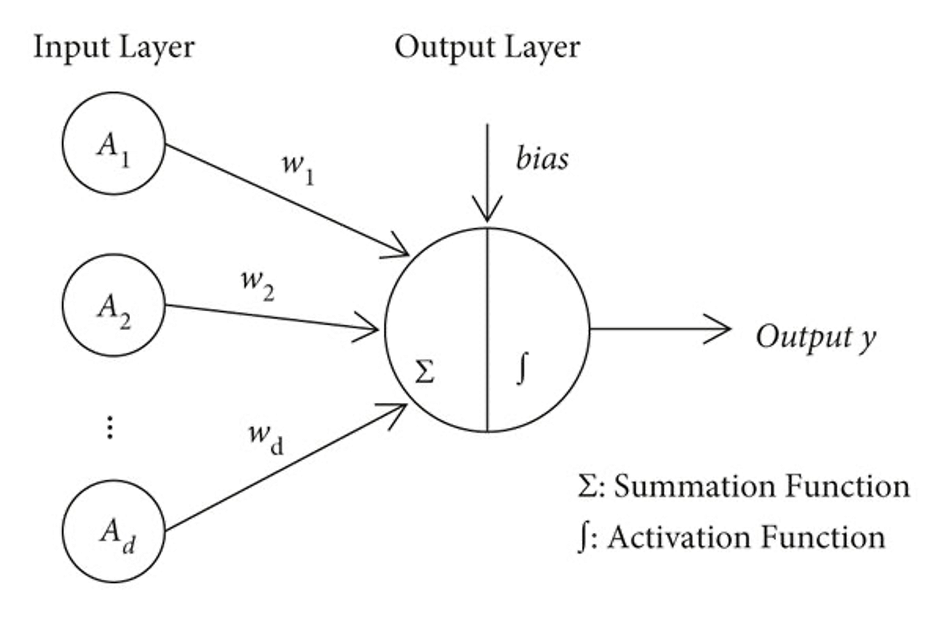
The Perceptron: The Core Building Block
The Perceptron is the foundational unit of deep learning.
It requires understanding Weights, which represent the "importance" of incoming data.
It utilizes Biases, which act as "thresholds" for the neuron to activate.
The neuron processes these inputs using summation math.

Slide 3
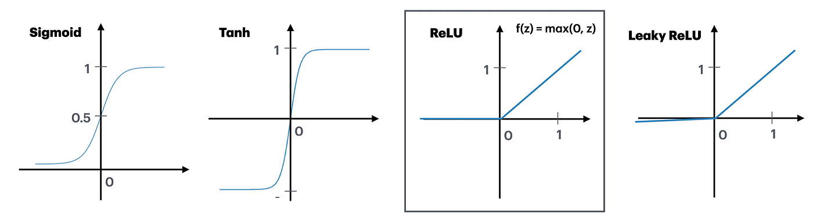

Activation Functions: Introducing Non-Linearity
Activation functions are critical for introducing non-linearity into the network, allowing it to learn complex patterns.
Traditional networks often use the $Sigmoid$and Tanh functions.
Modern deep learning primarily relies on ReLU and Leaky ReLU functions.

Slide 4
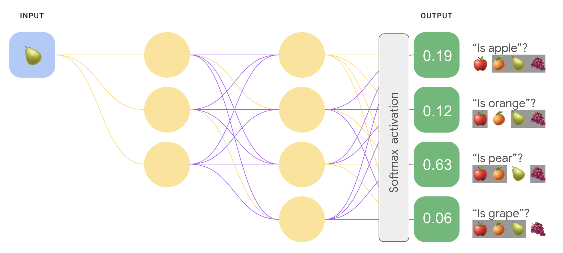
The Softmax Function: Multi-Class Decisions
The Softmax function is typically applied at the very end of a neural network.
Its primary job is converting raw scores (logits) into probabilities.
This makes it essential for multi-class decisions (e.g., deciding if an image is a cat, dog, or bird).

